Slide 1
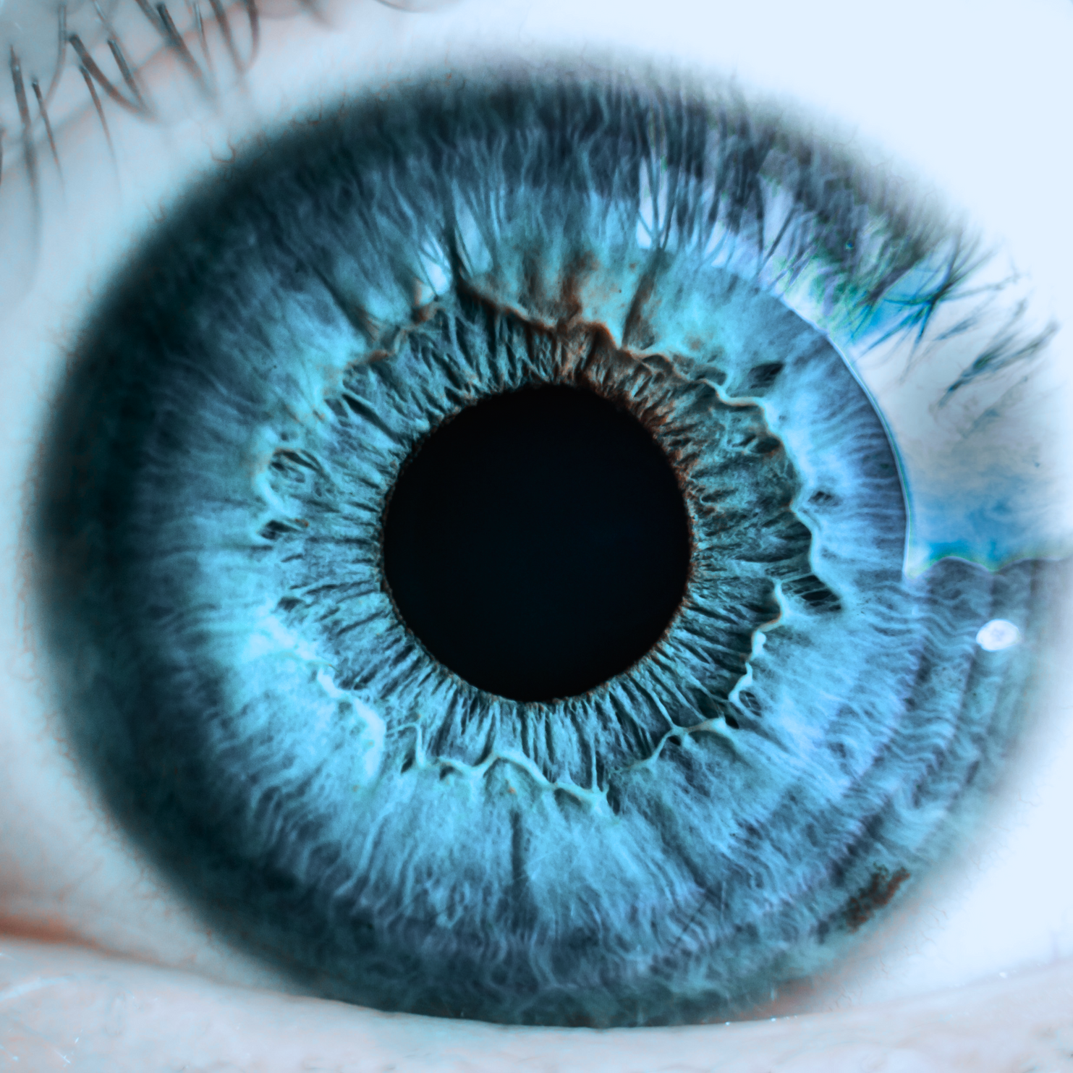
Image Retargeting For Visually Impaired
SC - FCIS ASU

Slide 2

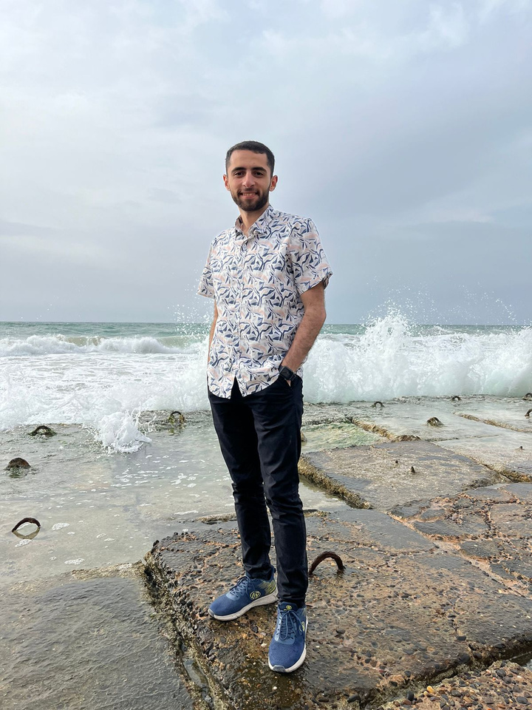
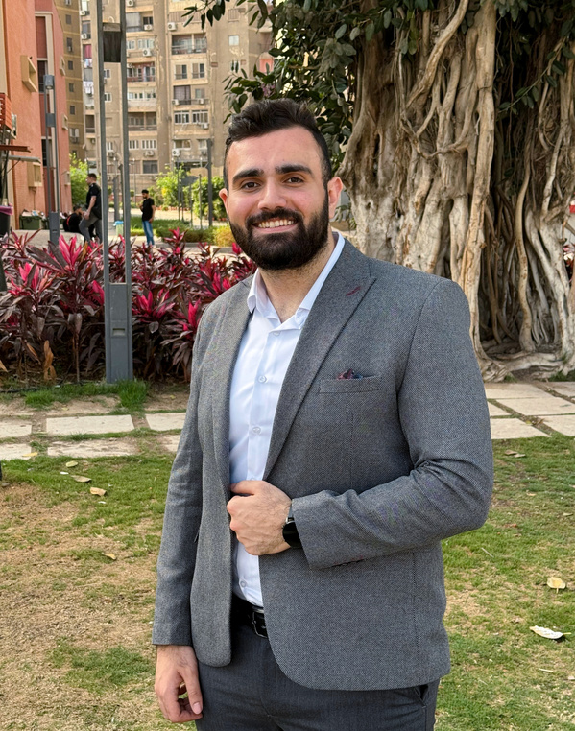
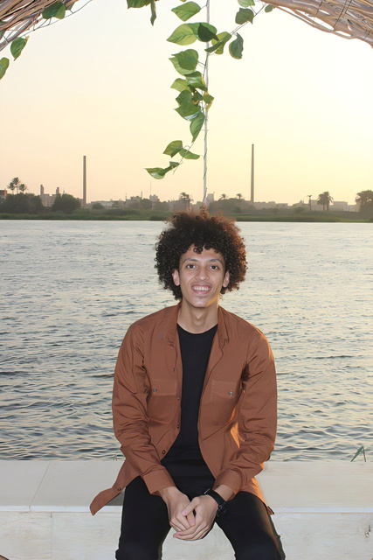
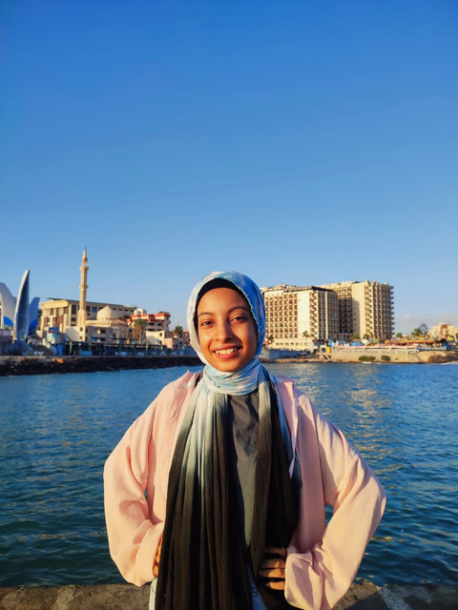
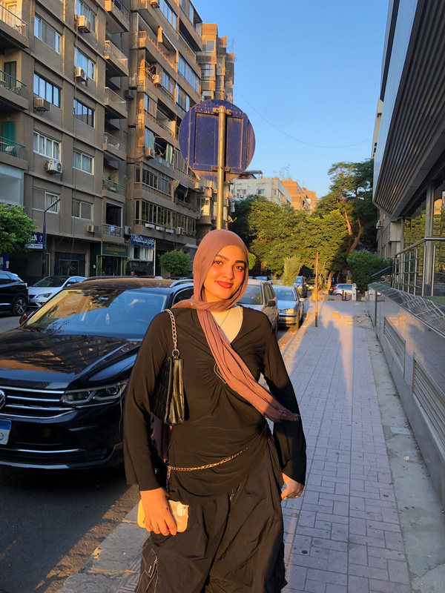
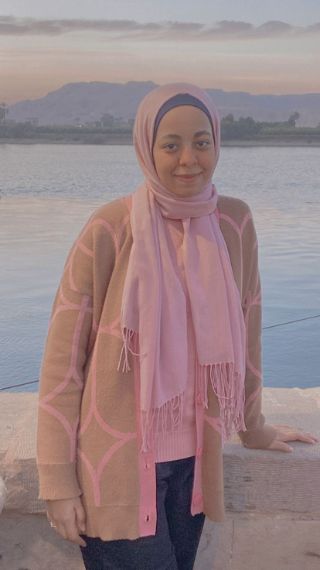
Ahmed Osama
Ahmed Moadamani
Mosaab Thabet
Our Team
Alaa Mostafa
Amira Yasser
Shahd Ashraf

Slide 3
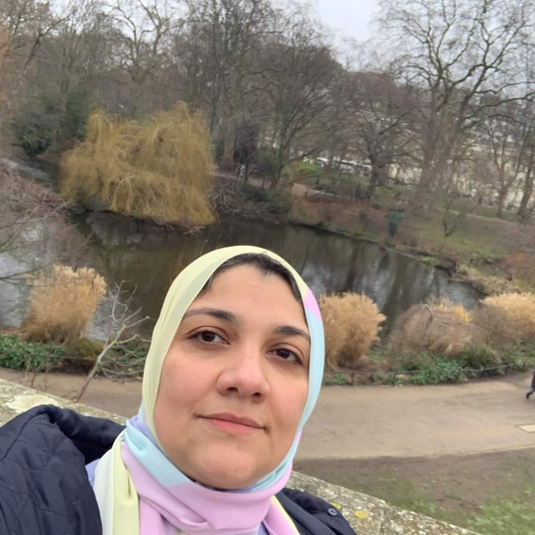
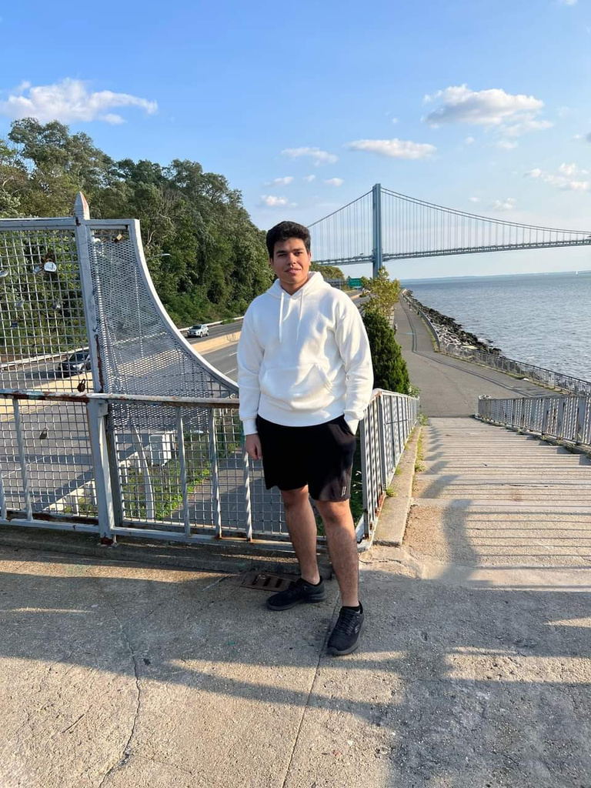
Meet Our Supervisors
Dr. Maryam Al-Berry
T.A. Hosam Sherif

Slide 4
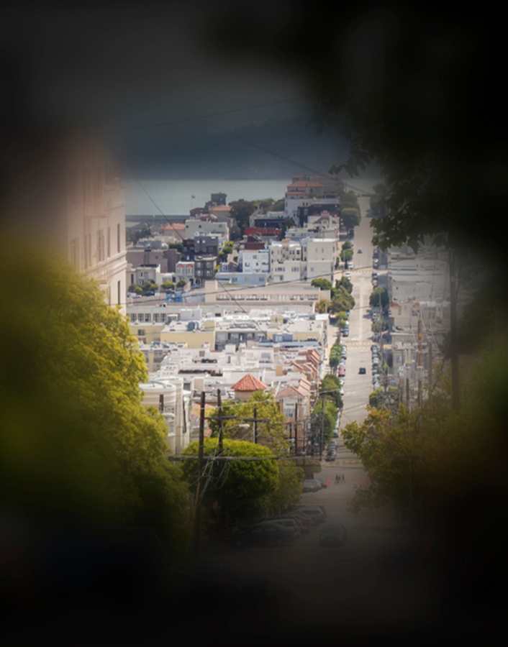
Agenda
Introduction
Problem Definition
Motivation
Objectives
Image Retargeting
Related Work
Methodology
System Implementation
Testing & Evaluation
System Architecture
Demo
Future Work

Slide 5
Introduction
What is RP?
RP is a rare, degenerative eye disease that gradually leads to vision loss.
Prevalence
RP affects approximately 1 in 4000 worldwide, with prevalence rates varying by region and ethnicity.
Degenerative Nature
RP is a degenerative disease, with vision loss gradually increasing over time and leading to legal blindness in severe cases.

Slide 6
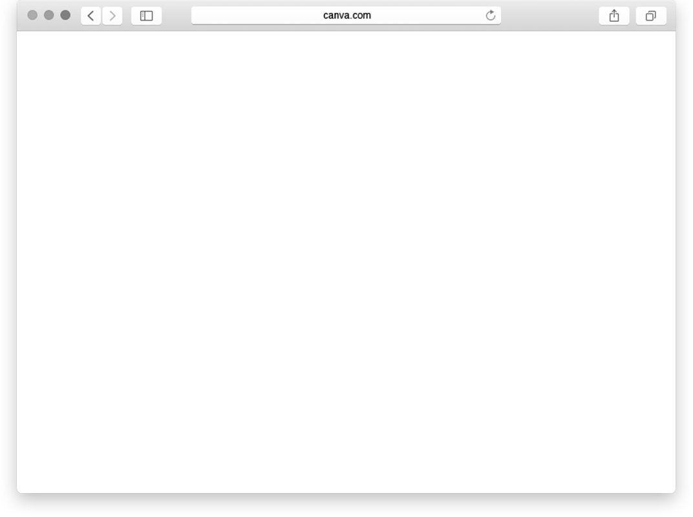
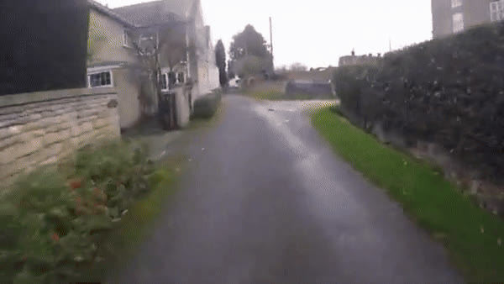
Problem Definition
Impact of Retinitis Pigmentosa (RP)
RP causes progressive vision loss, leading to tunnel vision or blindness, which severely limits visual perception.
Daily Life Challenges
Narrowed visual fields make reading, face recognition, and navigation difficult for RP patients, reducing their quality of life.

Slide 7
Problem Definition
Dynamic Adjustment
The method needs to adjust visual content in real-time, flexibly adapting to varying levels of vision impairment in RP patients and different types of visual media.
Limitations of Existing Solutions
Current technologies do not adequately address the specific visual needs of RP patients, lacking effective image retargeting capabilities.

Slide 8

Motivation
The motivation behind our project is to support individuals suffering from Retinitis Pigmentosa (RP) by addressing the significant lack of initiatives targeting their specific challenges.
Recognizing the pressing need for innovative solutions, our project employs image retargeting techniques to adapt visual content for RP patients. By customizing visuals to meet their unique needs, we aim to enhance their perception and interaction with the world, ultimately improving their quality of life.

Slide 9
Objectives
Adapting and enhancing visual content to make it more accessible and informative for RP individuals.
Enhancing current algorithms and methodologies to drive meaningful advancements in the scientific domain.
Enhancing their ability to navigate their environment, recognize faces, and engage with various forms of visual content.

Slide 10
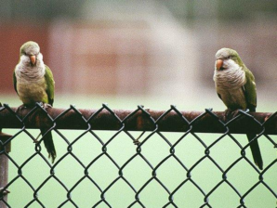
CONTENT-AWARE IMAGE RETARGETING (CAIR)
Image Retargeting
Image retargeting adapts images to various display sizes while preserving key content. It maintains essential elements across devices, optimizing screen space and enhancing the viewer's experience. This technique ensures visual content remains effective on different platforms and screen dimensions.

Slide 11
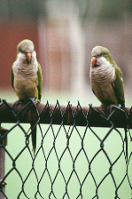
CONTENT-AWARE IMAGE RETARGETING (CAIR)
Image Retargeting
Image retargeting adapts images to various display sizes while preserving key content. It maintains essential elements across devices, optimizing screen space and enhancing the viewer's experience. This technique ensures visual content remains effective on different platforms and screen dimensions.

Slide 12
Related Work

Slide 13
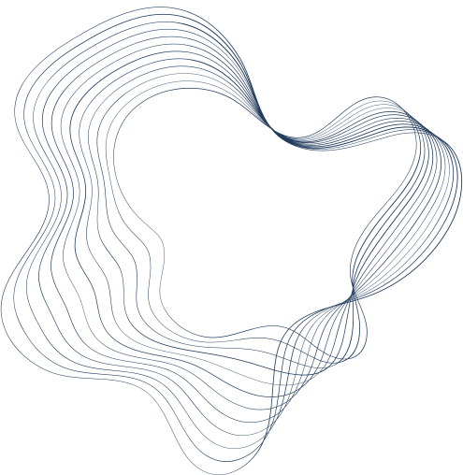
Related Work
Approaches in Image Retargeting
IMAGE RETARGETING METHODS
DATESETS
QUALITY MEASURES
BACKWARD SEAM CARVING,
FORWARD SEAM CARVING,
DEPTH ASSISTED SALIENCY MAP SEAM CARVING,
MULTI-OP
RETARGET ME ,
PASCAL VOC 2007
USER STUDY,SIFT,
EDGE HISTOGRAM,
CONTENT LOSS

Slide 14
Related Work
Challenges
2007-2009
2010-2014
2016-2024
considering the impact of removing a seam on the rest of the image.
FINDING THE RIGHT COMBINATION OF ENERGY FUNCTIONS TO ENABLE ROBUST AND EFFECTIVE CONTENT-AWARE RESIZING
ACHIEVING A GOOD BALANCE BETWEEN COMPUTATIONAL COMPLEXITY AND RETARGETING PERFORMANCE

Slide 15
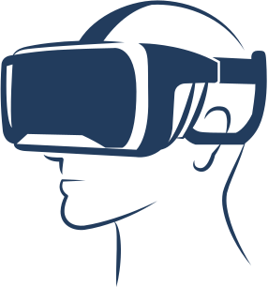
Methodology
After an extensive review of multiple research papers, it has become evident that the Seam Carving technique is the most used method in Image Retargeting.

Slide 16
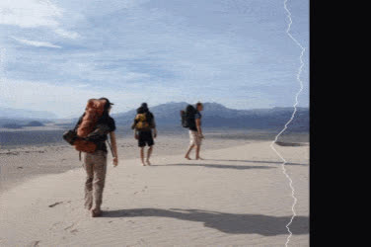
Seam Carving
Intelligently resizes images by removing or adding pixels along calculated low-energy paths (seams). This energy-based approach preserves important visual content while adapting images to different sizes and aspect ratios, outperforming traditional resizing methods.

Slide 17

System Implementation

Slide 18

Feature Extraction
Depth Estimation
Saliency Detection
Foreground Segmentation
Edge Detection
Multi-Scale Image Fusion

Slide 19
Depth Estimation
Depth Maps are representations of a scene that encode the distance of each pixel from the camera or viewer and provide spatial information about a scene.
MiDaS (Monocular Depth Sensing.):
it is a deep learning model designed for depth estimation from a single RGB image
uses encoder-decoder architecture, the encoder part uses pre-trained CNN model to feature extraction decoder part uses this information to indicates the relative distance of the objects in the scene.

Slide 20
Key Features
Speed & Real-Time
Fast, suitable for real-time applications.
Generalization
Excellent, due to diverse training datasets.
Accuracy
High, performs well across various environments.

Slide 21
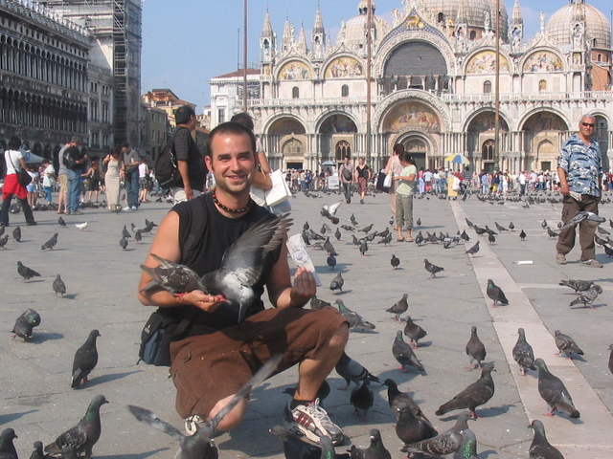
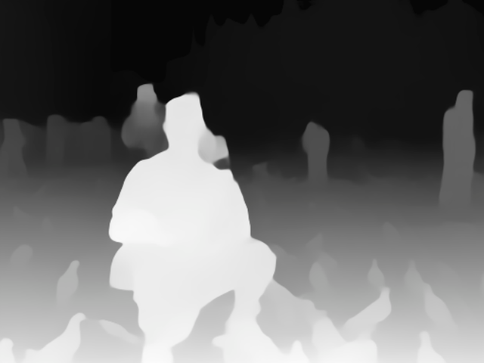

Why Depth Estimation?
It can help maintain the image's sense of depth and structure by prioritizing foreground elements and allowing background areas to be modified more freely.
Depth Map

Slide 22
Saliency Detection
This method It aims to highlight regions or objects in an image that stand out from their surroundings and are likely to capture an observer's focus.
U²-net:
is an innovative deep learning architecture designed for salient object detection. The architecture's name comes from its unique nested U-structure design This novel approach allows U2-Net to efficiently extract and process multi-scale features without relying on a pre-trained backbone network.

Slide 23
Key Features
Speed & Real-Time
Fast, suitable for real-time applications.
Generalization
Excellent, due to its multi-scale feature extraction.
Accuracy
High, performs well across various environments.

Slide 24
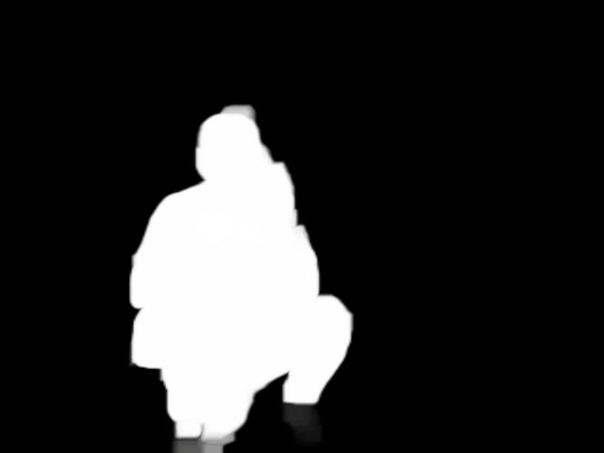
Why Saliency Detection?
as it identifies visually important regions in the image that naturally draw human attention. This helps preserve key subjects or focal points during resizing, ensuring that the most eye-catching elements remain intact.
Saliency Map

Slide 25
Foreground Segmentation
Foreground segmentation separates main subjects from the background. we used this with help of the depth map.
Mask R-CNN:
is an extension of the Faster R-CNN model, designed for object detection and instance segmentation tasks. It adds a branch for predicting segmentation masks on each Region of Interest (RoI) in addition to the existing branches for classification and bounding box regression.

Slide 26
Key Features
Architecture
Builds on Faster R-CNN by adding a parallel branch for mask prediction.
Generalization
Excellent, due to diverse training datasets.
Accuracy
High accuracy in both object detection and segmentation, capable of handling complex scenes with multiple objects.

Slide 27
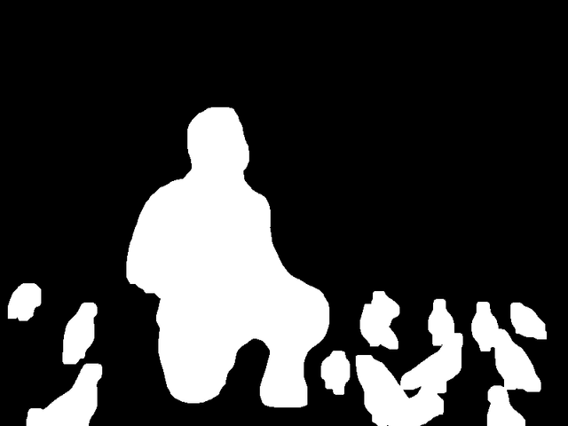
Why Foreground Segmentation?
In seam carving, this is invaluable for protecting the integrity of main subjects by giving it more importance weight than the background ones and sometimes it solves the saliency failure cases, allowing for more aggressive modification of background areas
Foreground Mask

Slide 28
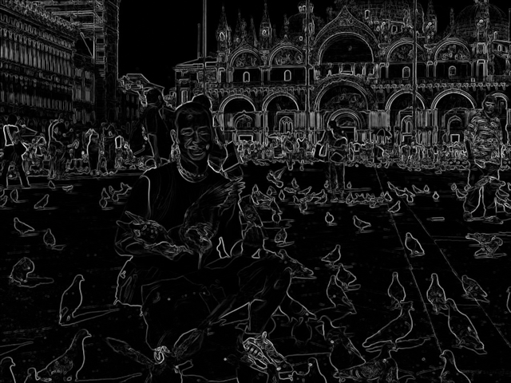
Edge Detection
Gradient maps highlight edges and texture changes in the image. This is crucial for preserving structural integrity and detail.
we used Sobel Filter to detect horizonal and vertical edges.
Greadient Map

Slide 29
Energy Map Generation
Multi-Scale Image Fusion
Multi-scale fusion is a technique used to combine multiple images, enhancing the final output by integrating information at various scales. To capture the fine details in small scales and the structure in large ones.
Calculation Details
Decompose input image into multiple scales or levels.
Extract relevant features or characteristics at each scale for all images.
Create weight maps for each scale of each image based on quality metrics.
apply fusion rules to combine information from all images at each scale.
Verify and ensure consistency of fusion results across scales.
Reconstruct the final fused image from the combined multi-scale information.

Slide 30
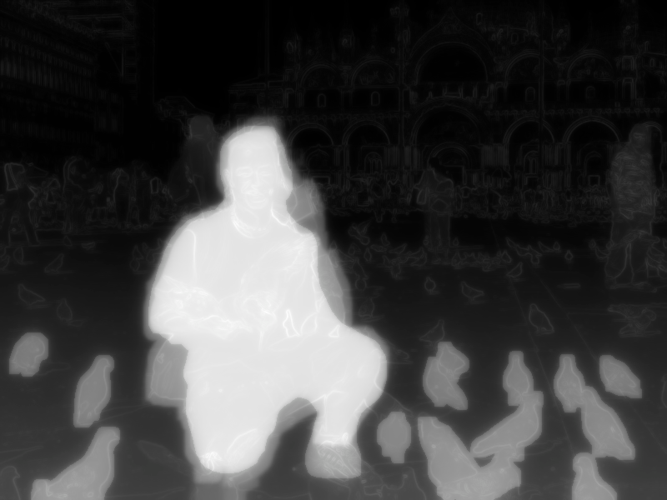

Illustration of the whole process
Multi-Scale Fusion
Energy Map

Slide 31
Seam Carving

Slide 32
Seam Carving Stages
Energy Calculation
In seam carving (SC), the energy accumulation of each pixel determines its importance to the image content.
1
Seam Removal
Seam removal iteratively identifies and removes the lowest energy accumulation seam.
2

Slide 33
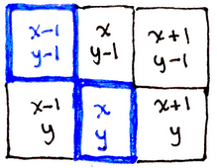
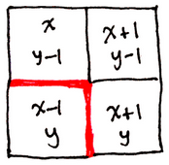
Energy Calculation is the first step in seam carving and considered the top-down part in the algorithm, it aims to get the energy accumulation of each pixel determines its importance to the image content. Higher energy means greater importance, while lower energy may result in removal in the next step.
Energy Calculation
Forward Energy:
Before
After

Slide 34
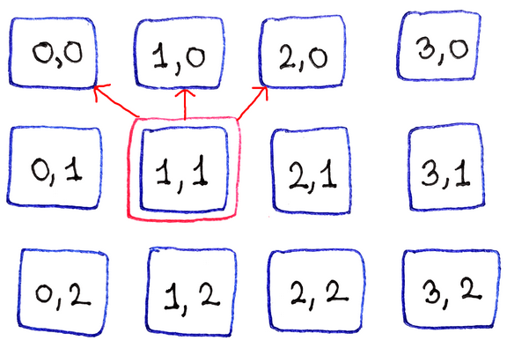
Seam Removal is the second step in seam carving and it’s the bottom-up part.
It iteratively identifies and removes the lowest energy accumulation seam. This process preserves core image content while removing less important parts based on the previous accumulation process, achieving desired resizing.
Seam Removal
Seams removal process:

Slide 35
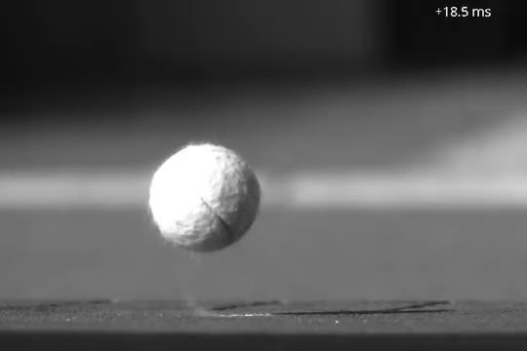
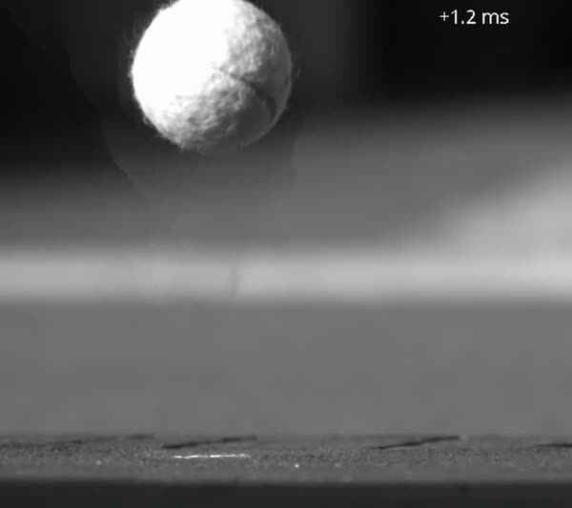
Video Retargeting
Video Retargeting led to some artifacts throughout the process. This occurred because the continuous motion of objects in each frame caused the seams to change direction, resulting in artifacts or unnatural motion when the frames were reassembled.
Before
After

Slide 36
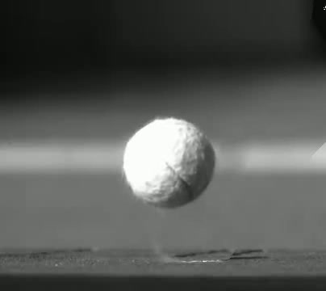
Video Retargeting
Energy calculation for a video is similar but broader. The main idea is to cache the previous frame for use in the current one. When accumulating energy for current pixel neighbors, consider the other frame's neighbors to avoid distortions.
Before
After

Slide 37
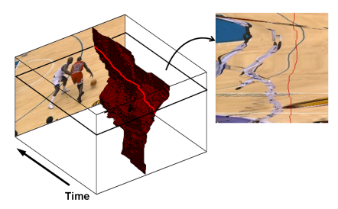
Video Retargeting
Another Method for video retargeting involves utilizing both the previous frame and the next frame simultaneously. This approach ensures better quality but at the cost of slower results due to the extensive time required for the accumulation process.
We chose not to implement it because it operates discretely and cannot accommodate new frames, whereas ours is designed to operate in real-time.

Slide 38


Testing & Evaluation
To ensure the success of our image retargeting solution, we have implemented a rigorous testing and evaluation process. Evaluation involves assessing both quantitative metrics and qualitative user feedback. These measures help ensure that the system meets users' needs and effectively enhances their visual experience.

Slide 39
Quantitative Quality Measures
Structural Similarity Index
Edge Histogram
It measures the similarity between two images.It evaluates image quality based on perceived structural information, considering luminance and contrast masking.
It represents the frequency and orientation of edges in different parts of an image. It provides a concise summary of the image's structural features.
Content loss
It’s used to quantify differences between two images based on high-level features, rather than pixel-wise comparisons.

Slide 40
Quantitative Quality Measures
Scale-Invariant Feature Transform (SIFT)
Peak Signal-to-Noise Ratio (PSNR)
Composite Score
used to evaluate the quality of a retargeted image compared to its original version ,where the goal is to preserve the original image's fidelity while minimizing the amount of data required
It’s a feature detection algorithm to measure the similarity between images, which is crucial for matching keypoints
It combines multiple quality measures and balances the strengths and weaknesses of individual metrics.By assigning weights based on each metric's importance

Slide 41
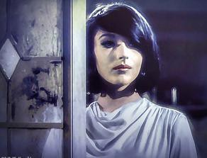
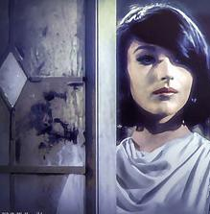
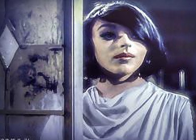
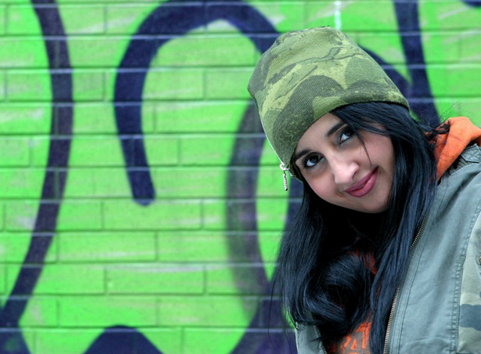
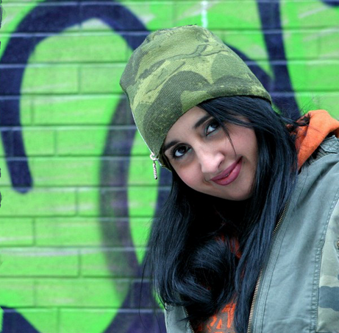
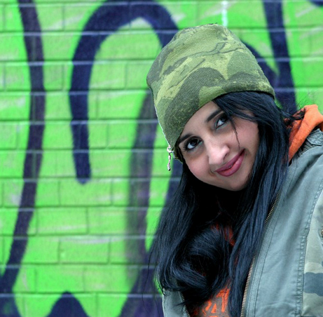
figure (1)
Quantitative Quality Measures
Seam carving library:
a tool used for content-aware image resizing. It works by identifying and removing or inserting seams (paths of least importance) in an image.
original
our algorithm
seam carving library
figure (2)
Visual representation:
we compared our results to the seam carving built in library results and here are some examples :
original
our algorithm
seam carving library

Slide 42
EXAMPLE OF QUALITY METRICS OF FIGURE (1)
time comparison:
ALGORITHM | CONTENT LOSS | SSIM | SIFT SIMILARITY | EH | PSNR | SCORE
OUR ALGORITHM | 0.170 | 0.7 | 97.3% | 0.019 | 41.2 | 47
BUILT IN LIBRARY | 0.093 | 0.3 | 75% | 0.024 | 10 | 36
We compared the retargeting times of our algorithm and the seam carving library. Our algorithm takes around 1.29 seconds for an average width of 650 pixels after removing 25% of the image, while the built-in library takes 3.04 seconds, indicating our algorithm is faster.
EXAMPLE OF QUALITY METRICS OF FIGURE (2)
conclusion:
ALGORITHM | CONTENT LOSS | SSIM | SIFT SIMILARITY | EH | PSNR | SCORE
OUR ALGORITHM | 0.210 | 0.74 | 99.3% | 0.01 | 10.5 | 45
SEAM CARVING LIBRARY | 0.110 | 0.46 | 69.6% | 0.03 | 10.5 | 32
Based on the examples shown above, the quality metrices scores , the composite score and time we found that our algorithm generally outperforms the seam curving library
We concluded that a score of 40 and higher indicates good quality, while scores below 40 show noticeable distortion.
OUR ALGORITHM

Slide 43
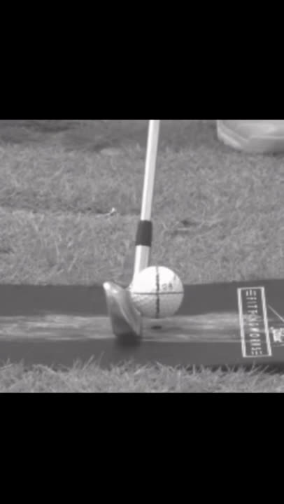
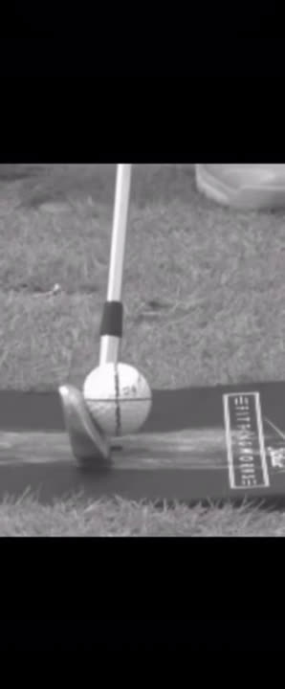
figure (1)
video retargeting evaluation:
we used the previous merics we used in image retargeting to evaluate the algorithm we used in video retargeting
EXAMPLE OF QUALITY METRICS OF FIGURE (1)
original
our algorithm
conclusion:
ALGORITHM | CONTENT LOSS | SSIM | SIFT SIMILARITY | EH | PSNR | SCORE
OUR ALGORITHM | 0.027 | 0.65 | 70% | 0.03 | 13.5 | 45
We calculated quality metrics for each video frame, including SSIM, content loss, edge histograms, SIFT feature similarity, and PSNR. The averaged results showed scores of 45 and higher, indicating good quality and similarity between the original and retargeted videos.

Slide 44


Qualitative Quality Measures
Survey Methodology:
We conducted an online qualitative survey to assess the quality of image retargeting for the visually impaired, asking participants to rate 10 pairs of original and retargeted images on a scale of 1 to 5 based on perceived quality and absence of distortions. The primary focus was on identifying distortions in the retargeted images.

Slide 45

Mean Opinion Score (MOS)
The Mean Opinion Score (MOS) quantifies subjective quality assessments by averaging all participant ratings, providing a single score that reflects the overall perceived quality of retargeted images, and is widely used in evaluating multimedia quality.

Slide 46
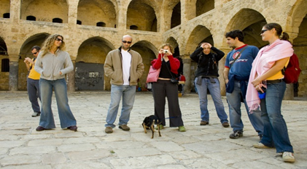
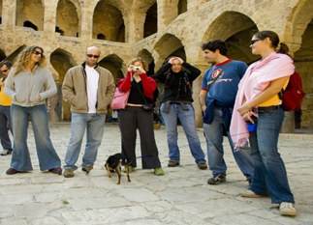
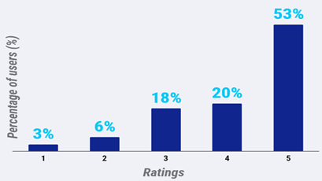
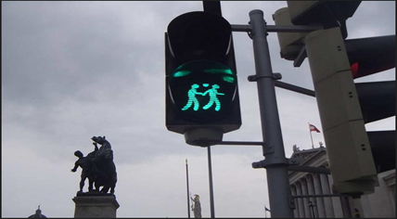
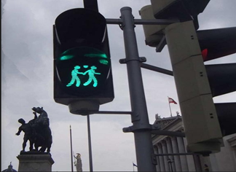
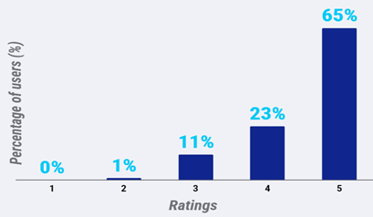
Survey Results Analysis
Original Image
Retargeted Image
Mean Opinion Score =4.11
Original Image
Retargeted Image
Mean Opinion Score =4.52

Slide 47
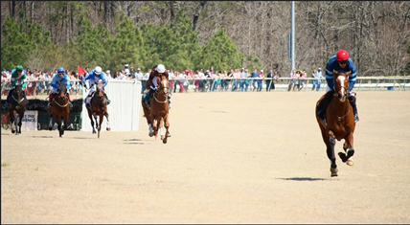
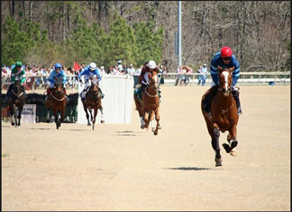
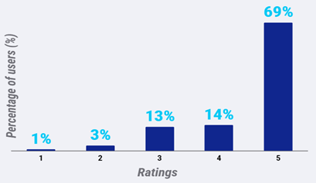
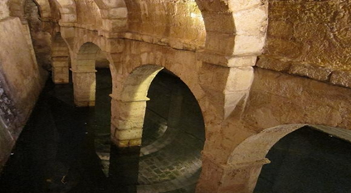
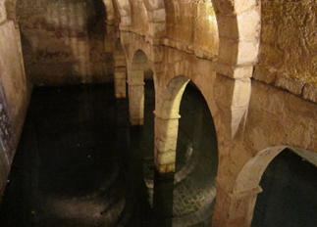
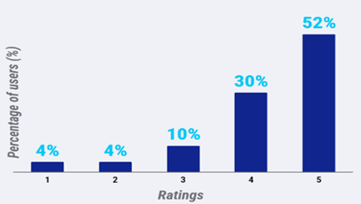
Survey Results Analysis
Original Image
Retargeted Image
Mean Opinion Score =4.45
Original Image
Retargeted Image
Mean Opinion Score =4.21

Slide 48






Survey Results Analysis
Original Image
Retargeted Image
Mean Opinion Score =4.27
Original Image
Retargeted Image
Mean Opinion Score =4.22

Slide 49
Survey Results Analysis
Conclusion:
Our image retargeting project for individuals with retinitis pigmentosa (RP) shows high effectiveness, with a Mean Opinion Score (MOS) of about 4 out of 5 across 10 sample images. This indicates minimal distortion and high similarity to the originals. Consistent results across images and metrics highlight the method's robustness and potential to enhance digital accessibility for RP patients, improving their visual experience by making images clearer within their limited field of vision.

Slide 50
System Architecture

Slide 51
Used Technologies
Flask
Used to create the backend for the web application, enabling quick setup of routes for handling Socket events back and forth with simplicity and flexibility.
SYSTEM
PyQt
Employed to develop the graphical user interface for the desktop application, providing extensive tools and widgets for a user-friendly design.
OpenCV
Utilized for reading and transforming images as well as edge detection, allowing effective processing and analysis of visual data.
PyTorch
Applied for its pretrained models to perform feature extraction in machine learning tasks, leveraging its dynamic computation graph and intuitive API for efficient development and experimentation.

Slide 52

System Architecture

Slide 53

System Pipeline
The Pipeline architecture in our back-end facilitates the seam carving process efficiently. Each thread is equipped with its own queue of frames, processing them sequentially to ensure smooth and organized operation.
This structure allows for parallel processing, improving performance and enabling the handling of multiple frames simultaneously without bottlenecks.

Slide 54
Demo

Slide 56
Future work

Slide 57
To Be Done..
A dataset of before-and-after images will be created to train a neural network to simulate the seam carving algorithm, aiming to improve its accuracy and effectiveness.
Speeding up the seam carving algorithm by implementing it in a low-level language like C or C++, enhancing processing efficiency for real-time use.
Integration of the algorithm into a VR environment will be developed to aid retinitis pigmentosa patients, allowing real-time visual adjustments for improved navigation.

Slide 58
Any Questions?

Slide 59

Thank You!

